Slide 1
SAP EWM EXTENDED WAREHOUSE MANAGEMENT TRAINING
AnubhavTrainings.com
www.anubhavtrainings.com

Slide 2

SAP EWM TRAINING
BY:-
Mr. Bijoy
www.anubhavtrainings.com
Notes:
https://unsplash.com/photos/uXB-7la5vqA

Slide 3
SAP EWM TRAINING (Day 02)
AnubhavTrainings.com

Slide 4
SAP EWM Business processes
EWM Business processes
Introduction to EWM terms
End to End Inbound process overview
End to End Outbound process overview
Internal Warehouse activities overview

Slide 5
EWM MASTER DATA
Contents
Create Bin Sorting In Tcode - /Scwm/Sbst
Determine Warehouse Process Type
Define Putaway Search Strategy
Maintain Warehouse Data In Ewm Product Master
Document Type Integration (For Inbound Delivery)
Map Item Types From Erp To Ewm
Storage Type Creation
Storage Section
Define Activity
Define Activity Area
Define Warehouse Process Type
Define Warehouse Number Control
Define Sort Sequence For Activity Area

Slide 6
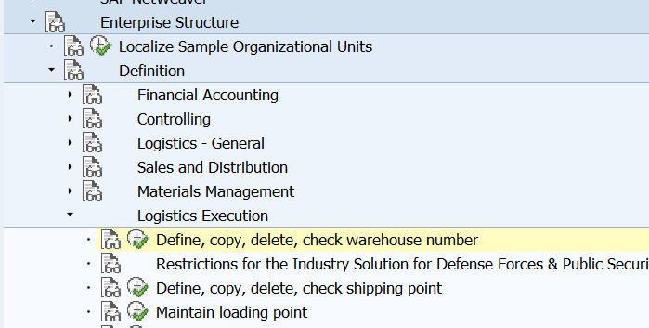
Storage Type Creation

Slide 7
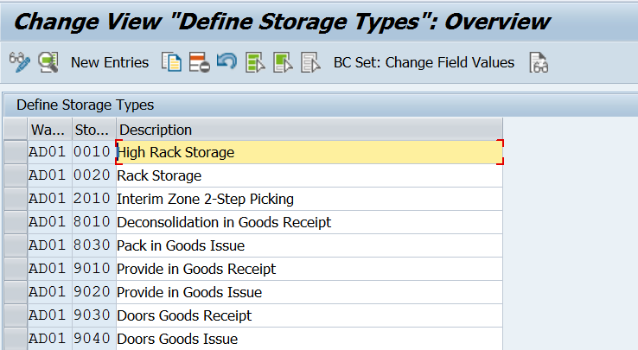
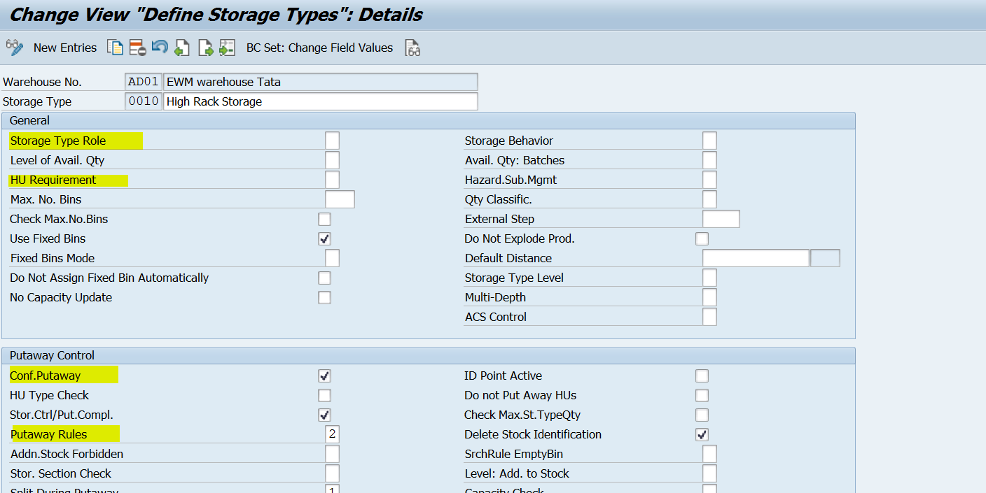
www.anubhavtrainings.com

Slide 8
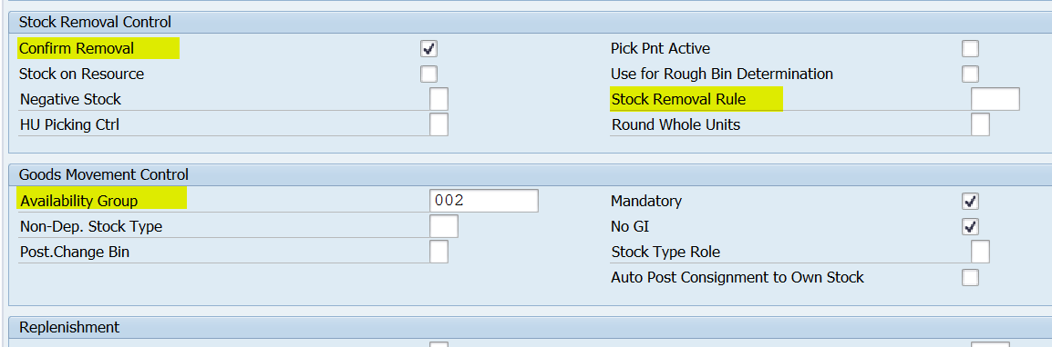

Slide 9
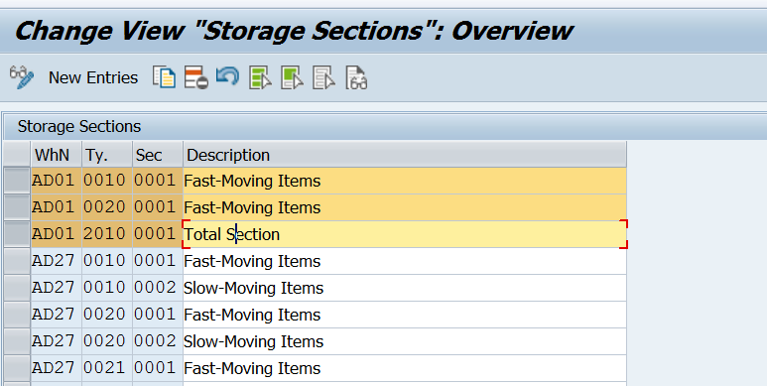
Storage Section
www.anubhavtrainings.com

Slide 10
Define Activity
An activity in a warehouse that triggers goods movements.
Examples of activities:
Perform physical inventory
Perform picking
Perform replenishment
Perform putaway
An activity must be uniquely assigned to a warehouse process category.
www.anubhavtrainings.com

Slide 11
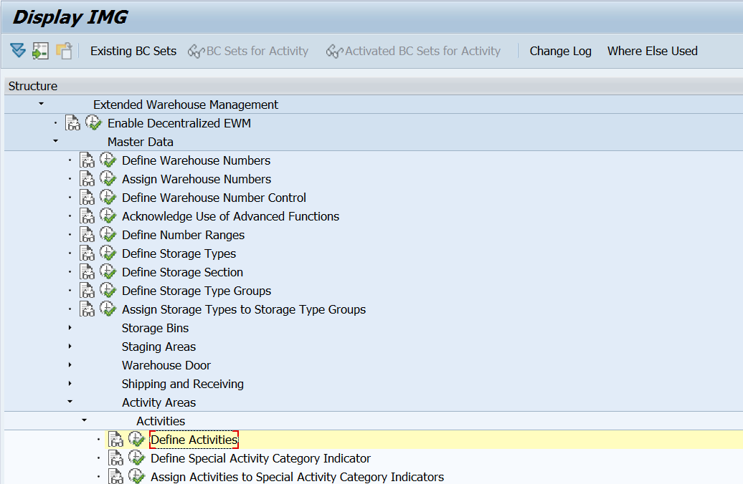
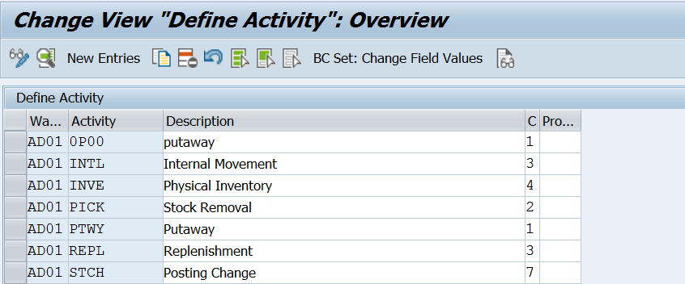

Slide 12
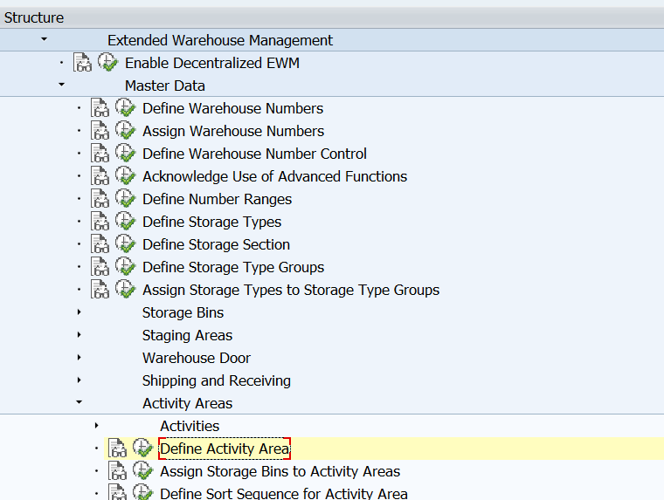
Define Activity Area
Logical area of the warehouse, which groups storage bins together with regards to specific warehouse activities.
Examples of activity areas: Putaway, Picking, Physical inventory
Create Bin sorting using tcode - /scwm/sbst

Slide 13
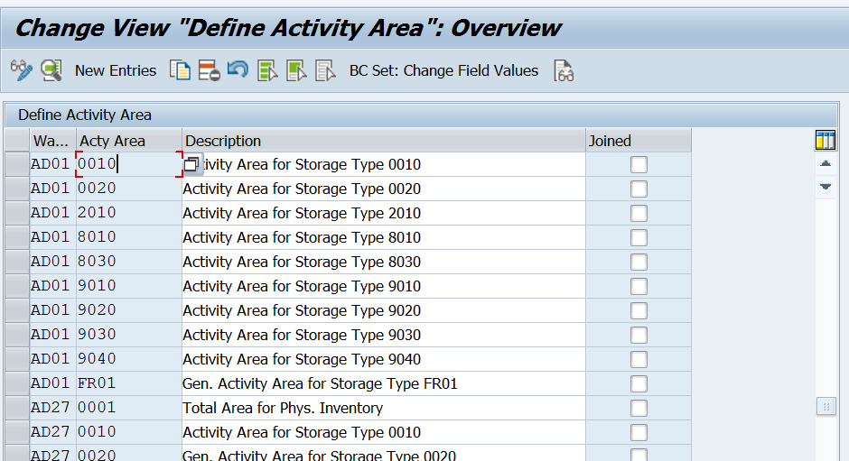
Define Activity Area

Slide 14
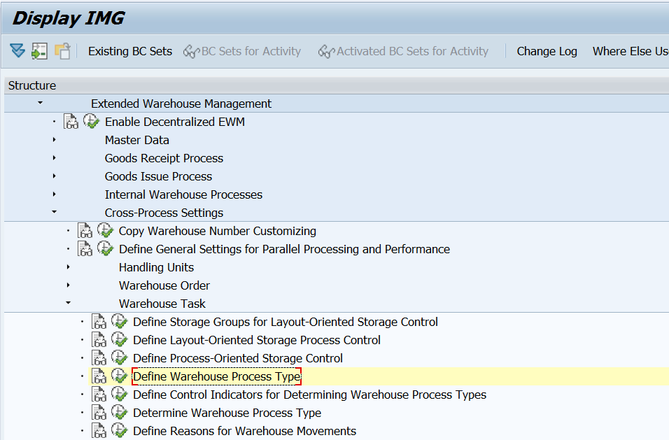
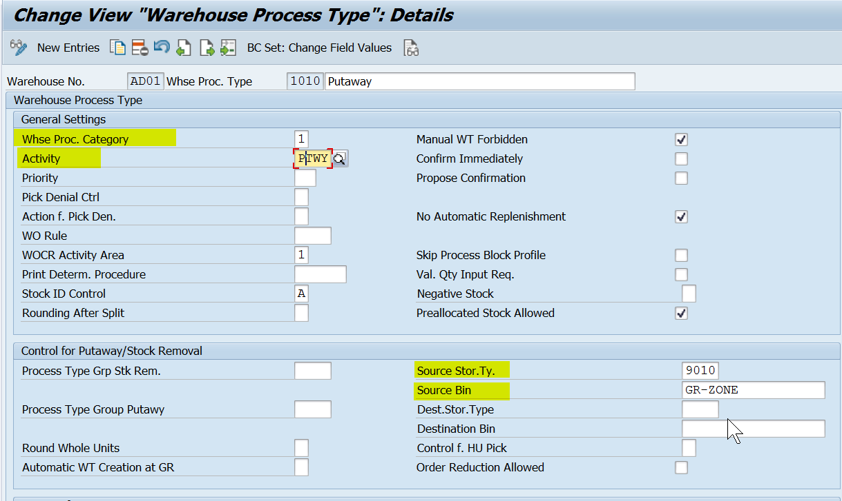
DEFINE WAREHOUSE PROCESS TYPE (*acts as EWM mvt type)
The system processes each warehouse process (such as goods receipt, goods issue, posting change,
and repacking) using a warehouse process type. the warehouse process type has various effects on the creation of warehouse tasks.

Slide 15
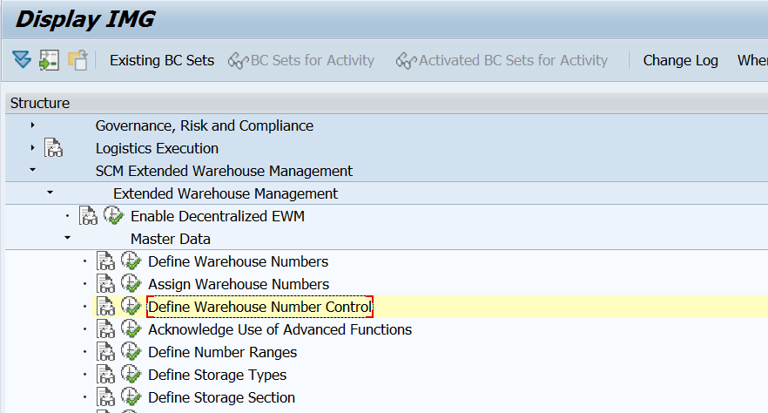
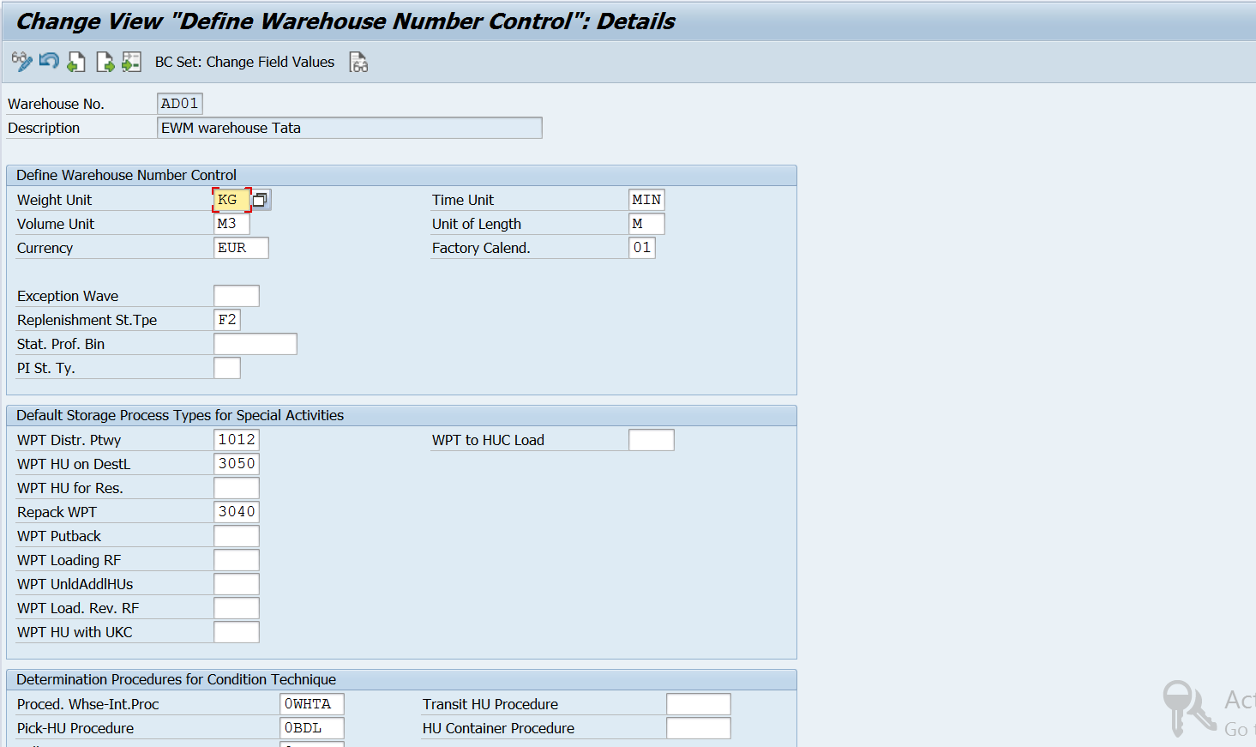
Define Warehouse Number Control
In this Customizing activity, you define the basic data for a warehouse number for SAP Extended Warehouse Management.
www.anubhavtrainings.com

Slide 16
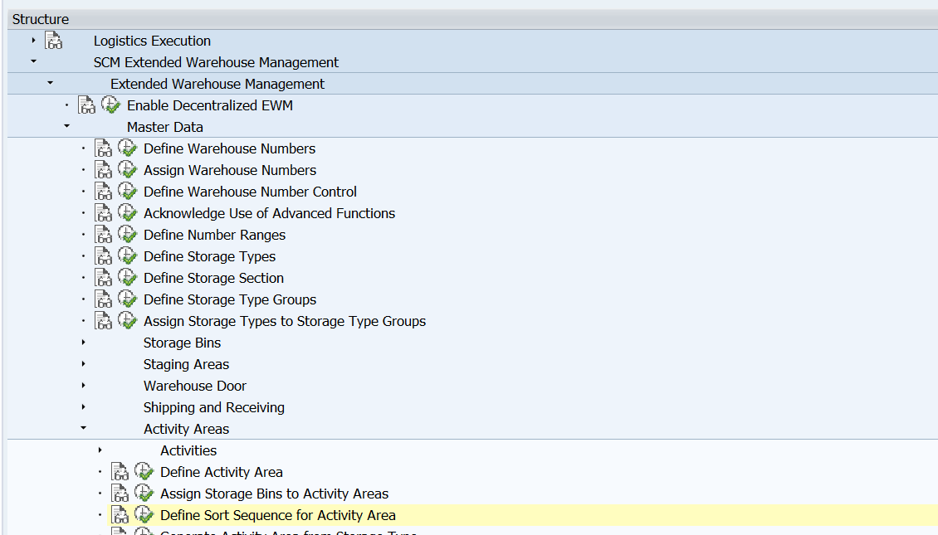
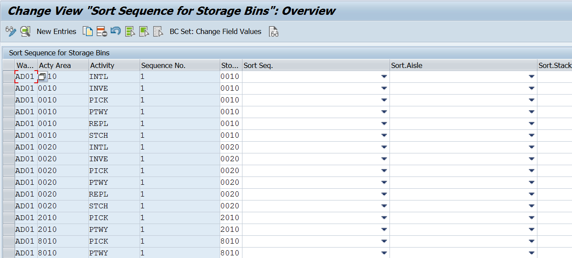
Assign Storage Bins to Activity Areas
Define Sort Sequence For Activity Area
In this IMG activity, you define the sorting rules within an activity area for all activities except cross-line stock putaway.
www.anubhavtrainings.com

Slide 17
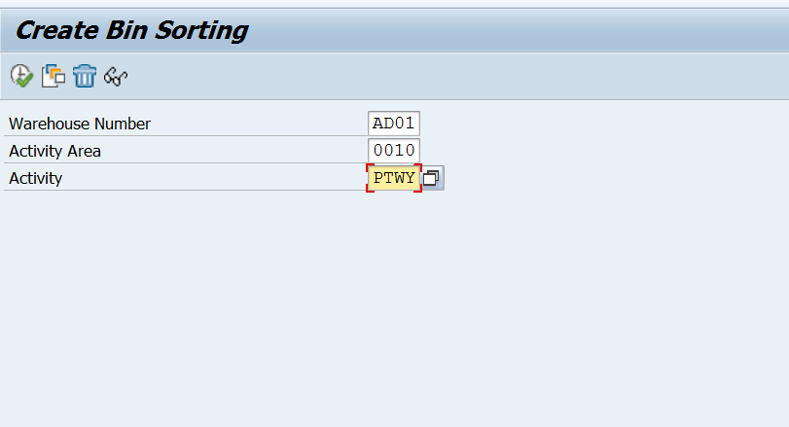
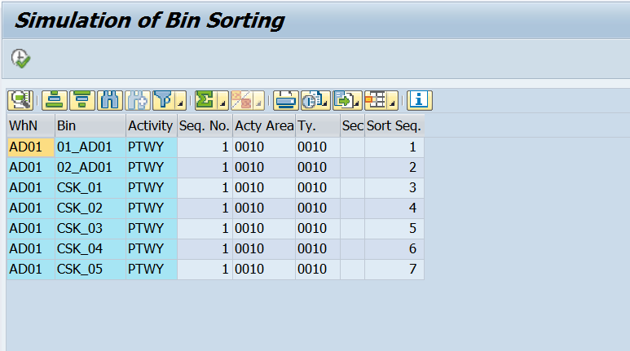
Create Storage bins in System - /scwm/ls01
Create Bin Sorting In Tcode - /Scwm/Sbst

Slide 18
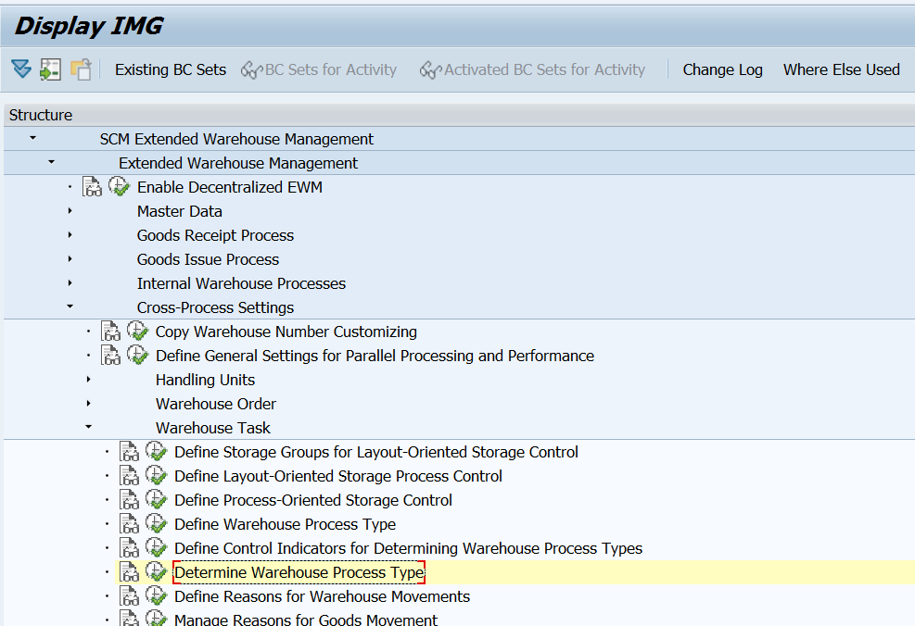
Determine Warehouse Process Type
In this Customizing activity, you can configure the automatic determination of the warehouse process type.
When Extended Warehouse Management (EWM) creates a warehouse request, it automatically determines the warehouse process type.
E.g. Assignment between delivery doc type (INB) to Warehouse process type (1010)
www.Anubhavtrainings.Com

Slide 19
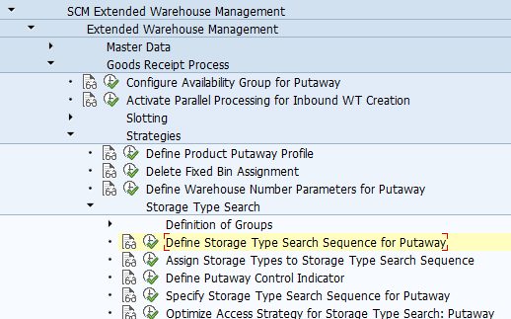
Define Putaway Search Strategy
Specific Inbound Config
Now one by one configure each step in the above given screenshot.
www.anubhavtrainings.com

Slide 20
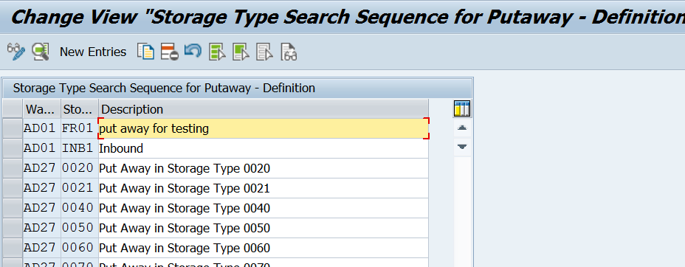
(A) Define Storage Type Search Sequence For Putaway.
www.anubhavtrainings.com

Slide 21
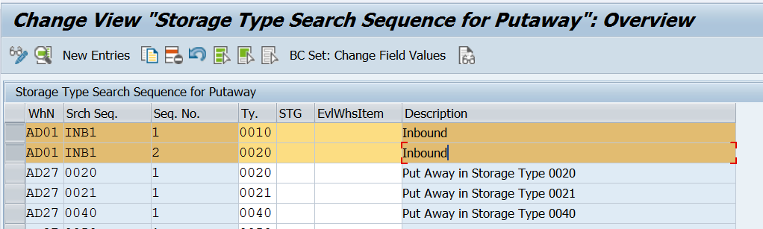
(B) Assign Storage Types To Storage Type Search Sequence
www.anubhavtrainings.com

Slide 22
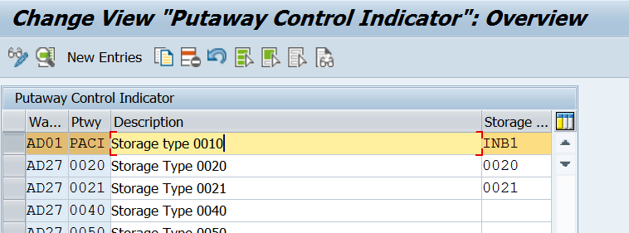
(c) Define Putaway Control Indicator.
www.anubhavtrainings.com

Slide 23
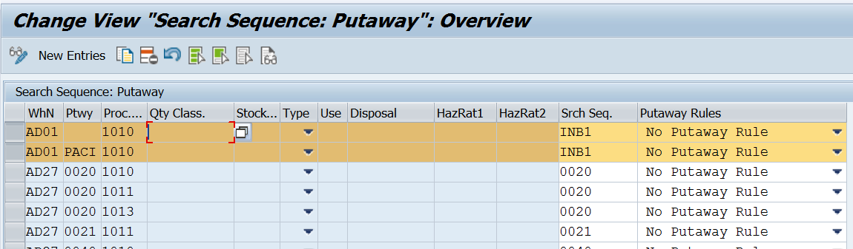
(D) Specify Storage Type Search Sequence For Putaway
www.anubhavtrainings.com

Slide 24
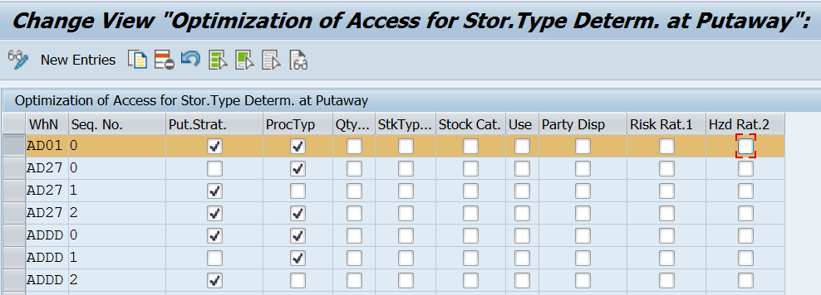
(E) Optimise Access Strategy For Storage Type Search: Putaway
www.anubhavtrainings.com

Slide 25
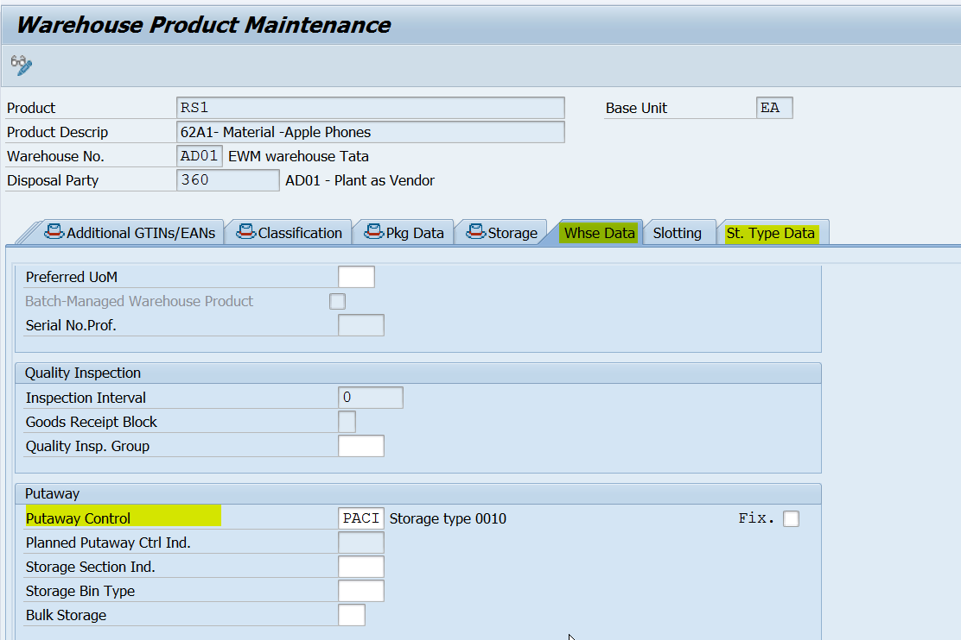
Maintain warehouse data in ewm product master (/scwm/mat1)
This is the field which will connect the search sequence through putaway control indicator.
www.anubhavtrainings.com

Slide 26
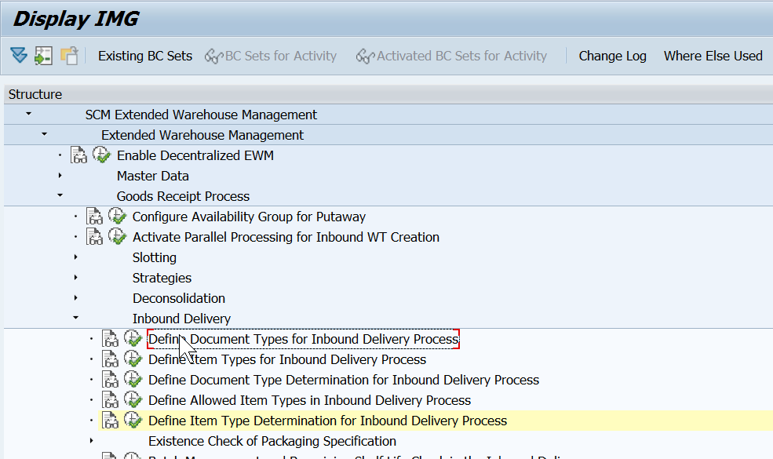
Document Type Integration (For Inbound Delivery)
Check this 5 nodes, it is standard configuration which is pre-defined by SAP.
www.anubhavtrainings.com

Slide 27
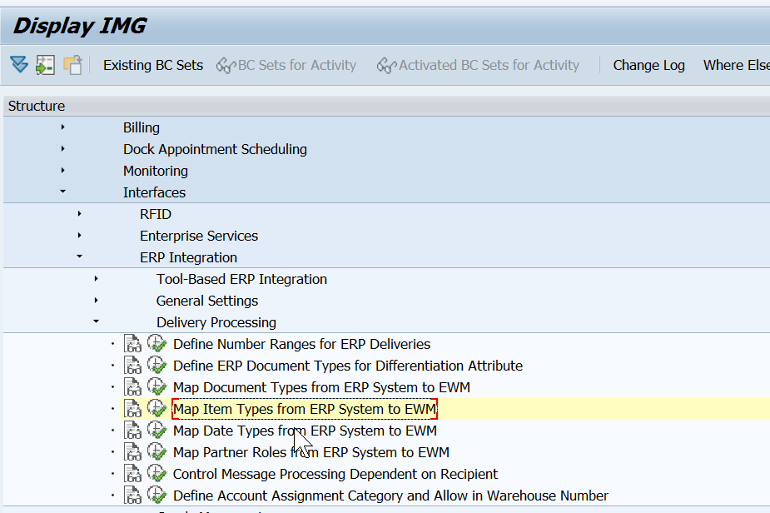
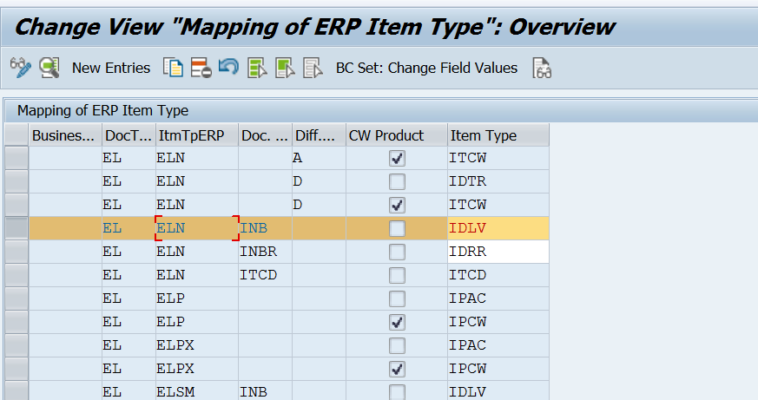
Map Item Types From Erp To Ewm
Integration point between ERP and EWM for determining delivery types/item types
www.anubhavtrainings.com

Slide 28


End of Session 02
www.anubhavtrainings.com

Slide 29

FEEL FREE TO ASK QUESTIONS

Slide 30

Feedback

Slide 31
THANK
YOU

Slide 32

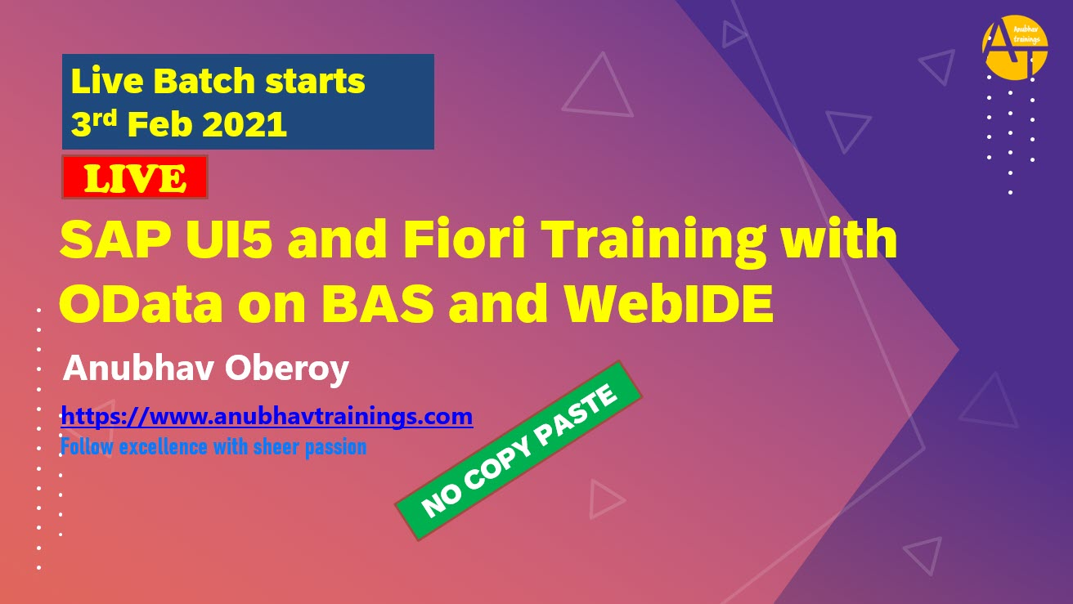

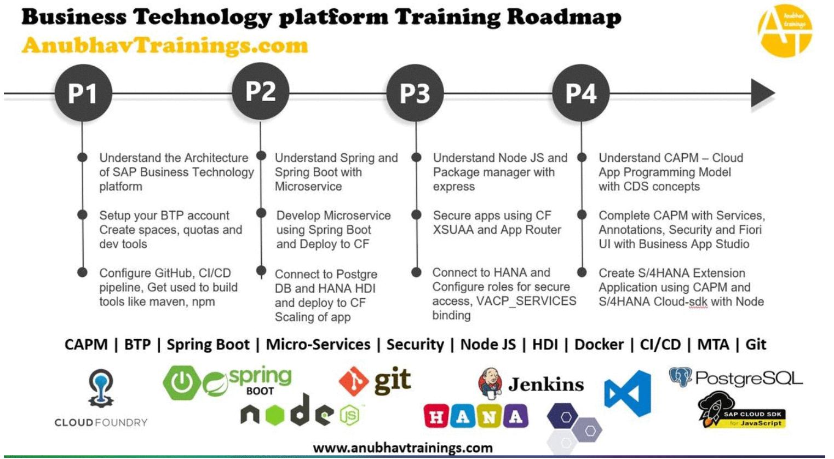
More from AnubhavTrainings.com

Slide 33






We’re committed to empower you to be
#FutureReady
through powerful training solutions.
We build the workforce of the future.
250+
Corporate Clients
30,000+
Learners Trained
25000+
Learners Placed
FREE WEBINARS
Sign up for free webinars with industry experts every fortnight!
Enroll Now!

Slide 34
FREE WEBINARS
Sign up for free webinars with industry experts every fortnight!
Contact us today!
www.anubhavtrainings.com

